Slide 1
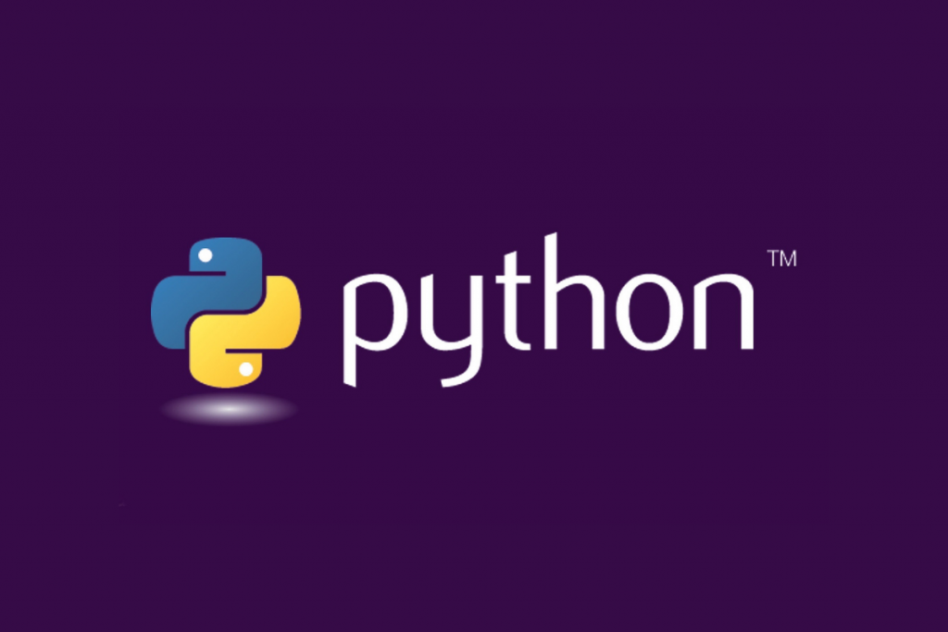
Basic
Data Manipulation

Slide 2
Introduction
Python is a powerful and versatile programming language that is widely used in various fields such as web development, data analysis, artificial intelligence, and more. In this presentation, we will explore the foundational concepts of Python programming. Throughout this session, we will cover topics such as string indexing, list operations, lambda functions, list comprehensions, dictionaries, built-in functions, looping, inheritance, and user-defined functions (UDFs) etc. By the end of this presentation, you will have a solid understanding of the basic building blocks of Python and be well-equipped to start writing your own Python programs.

Slide 3
Objectives
String Manipulation: Learn essential string manipulation techniques, including indexing, slicing, and basic string operations.
List Operations: Master list manipulation techniques, including list creation, appending, slicing, and list comprehensions.
Functional Programming: Explore functional programming concepts in Python, including lambda functions and map, filter, and reduce functions.
Dictionary Operations: Learn about dictionaries and how to perform common operations such as adding, updating, and deleting dictionary elements.
Looping Constructs: Understand different looping constructs in Python, including for loops, while loops, and loop control statements.
Inheritance and Polymorphism: Explore object-oriented programming concepts like inheritance and polymorphism and learn how to implement them in Python.
User-Defined Functions: Gain proficiency in writing user-defined functions to modularize code and improve code reusability.

Slide 4

STRING
INDEXING
String indexing refers to accessing individual characters of a string by their position. Each character in a string is assigned a number starting from 0 for the first character, 1 for the second character, and so on, this can be used to retrieve and manipulate individual characters at desired positions in a string easily.

Slide 5
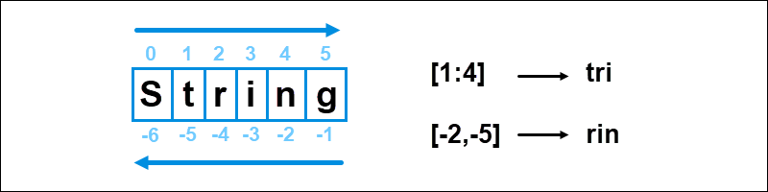
Syntax of
String
Indexing -
Positive indexing starts from left
Negative indexing starts from right

Slide 6
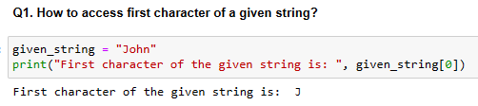
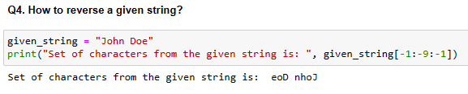
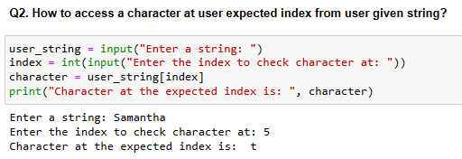
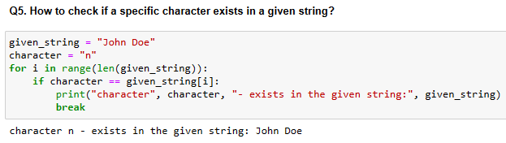
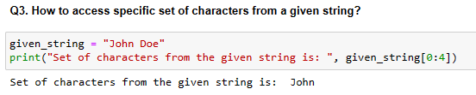
Examples of String Indexing -

Slide 7
LIST
OPERATIONS
List operations refer to various actions that can be performed on lists. A simple new element can be added to the end of a list using the append() method, or multiple elements can be added using extend() or can removed using pop() method. Order of a list can be reversed with reverse() method, startswith() method can be used to check whether a string starts with a specified prefix.

Slide 8
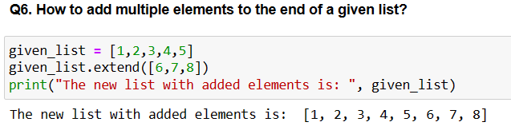
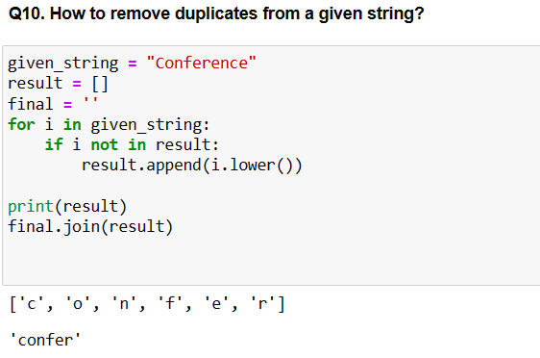
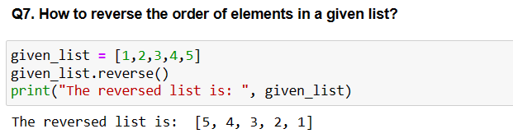
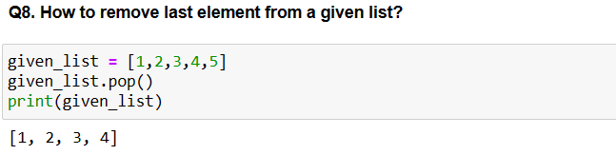
Examples of List Operations -

Slide 9
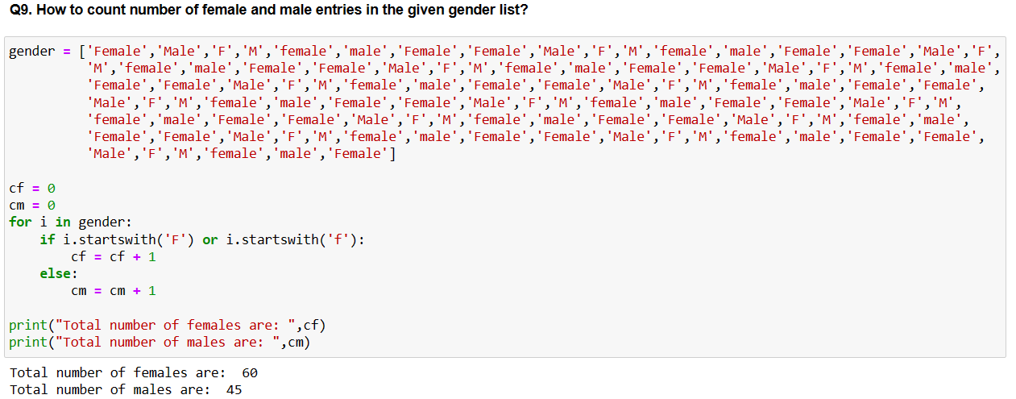
Examples of List Operations -

Slide 10
LAMBDA
FUNCTIONS
Lambda functions are defined inline functions without a formal name. They are typically used for small, simple tasks and fit on a single line of code.

Slide 11
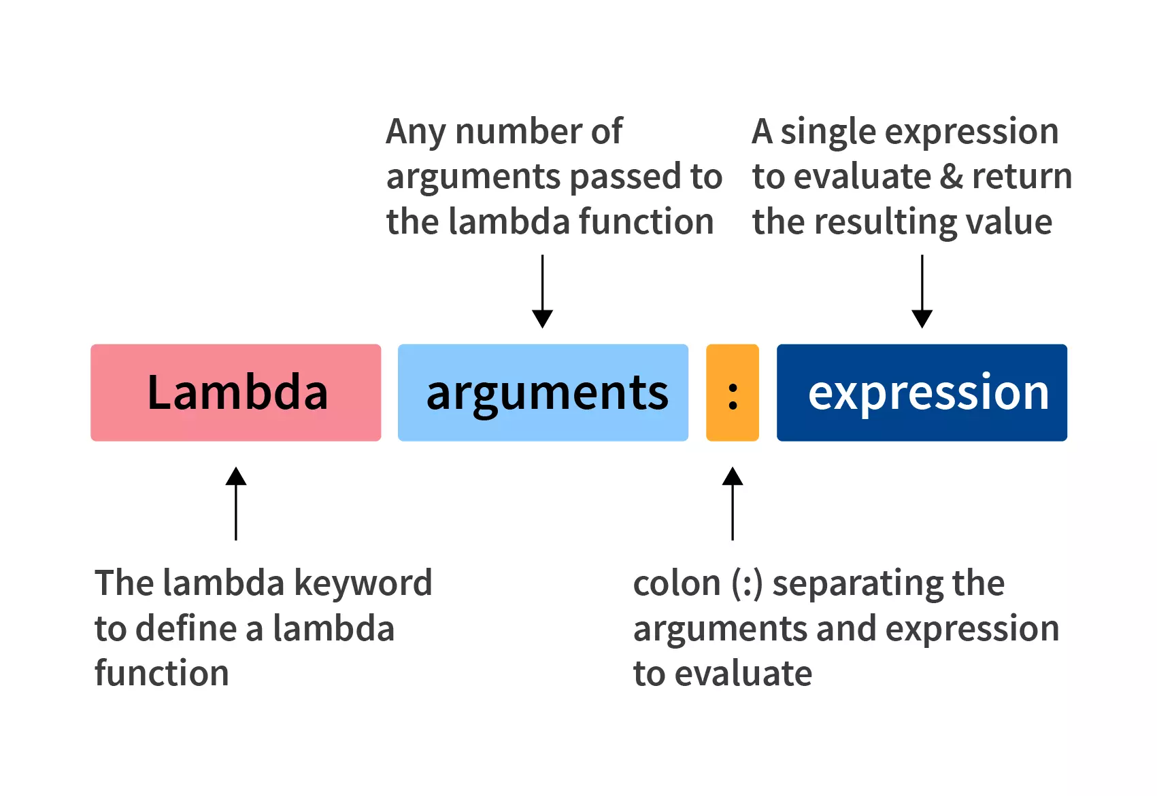
Syntax of
Lambda
Function -

Slide 12
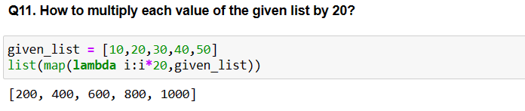
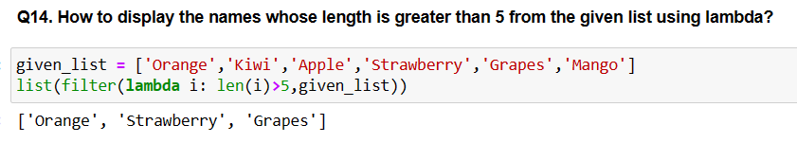
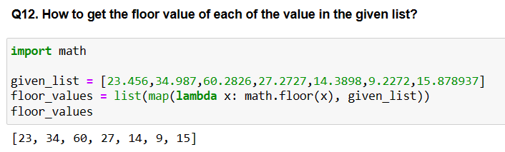
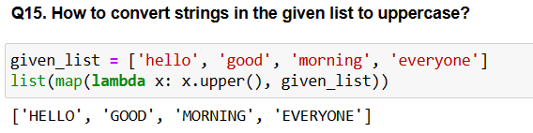
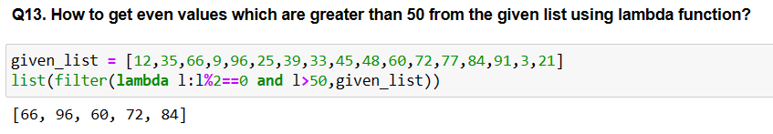
Examples of Lambda Functions -

Slide 13
LIST
COMPREHENSION
List comprehension generates a new list by applying an expression (sum, multiply etc) to each item in an existing iterable (like a list, tuple, or range) and filtering the items based on a condition.

Slide 14
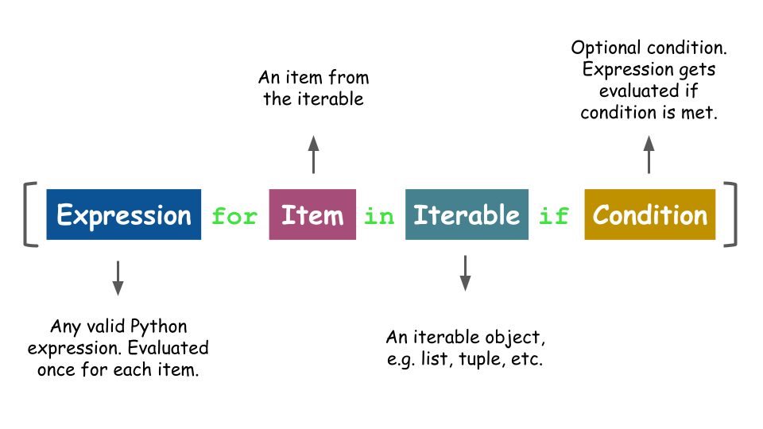
Syntax of List
Comprehension -

Slide 15
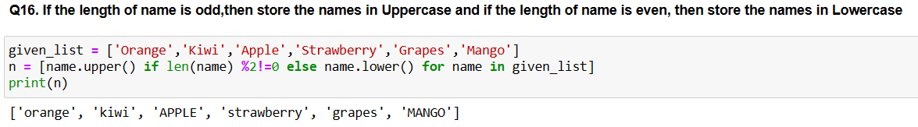
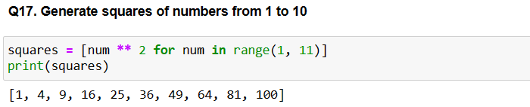
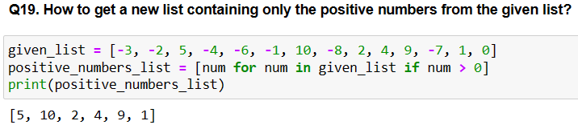
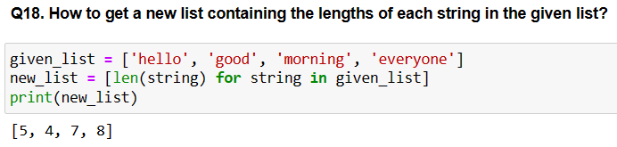
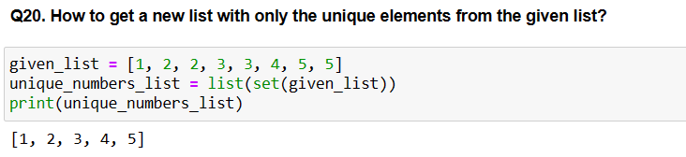
Examples of List Comprehension -

Slide 16
DICTIONARIES
Dictionaries are collections of key-value pairs, where each key is unique and refers to a respective value. Value associated with a key can be accessed by using square brackets [] with the key inside.

Slide 17
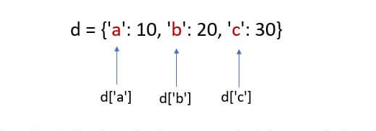
Syntax of List
Dictionaries -

Slide 18
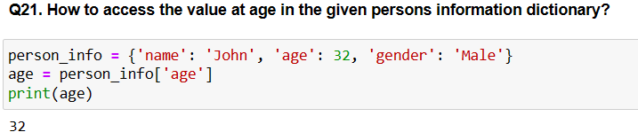
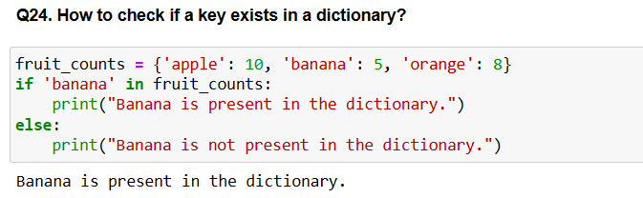
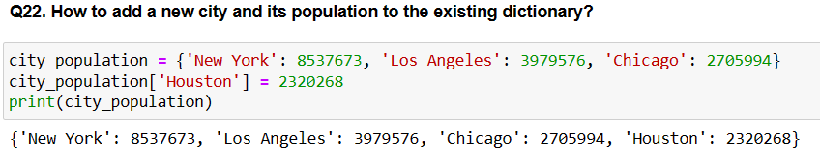
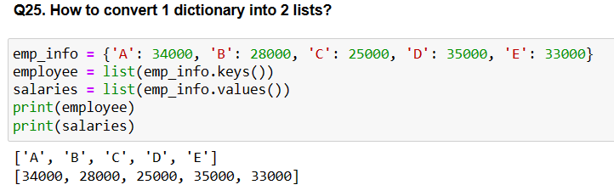
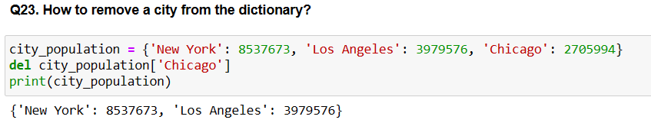
Examples of Dictionaries -

Slide 19
BUILT-IN
FUNCTIONS
Built-in functions are pre-defined functions, they have various purposes and can perform common tasks such as mathematical calculations, string manipulation, data type conversion, input/output operations, and more. Some common examples of built-in functions len() for getting the length of a sequence (such as a string, list, or tuple), sum() for calculating the sum of elements in an iterable, sorted() to sort the sequence etc.

Slide 20
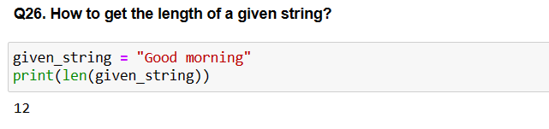
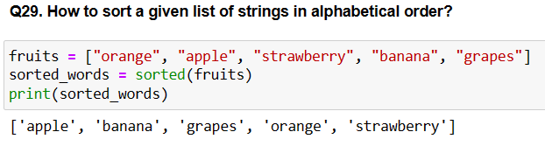
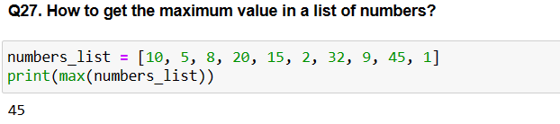
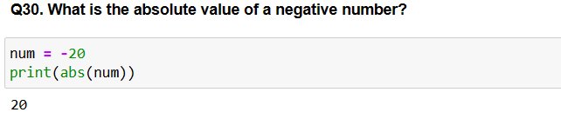
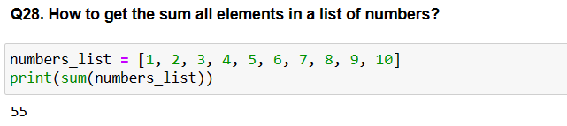
Examples of Built-in Functions (len, max, sum, sorted, abs) -

Slide 21
LOOPING
Looping is a technique used to repeat a block of code multiple times. It allows us to automate repetitive tasks and process large amounts of data efficiently. For loop is used when we know in advance how many times we want to repeat the code. While loop repeatedly executes the code block as long as the specific condition remains true.

Slide 22
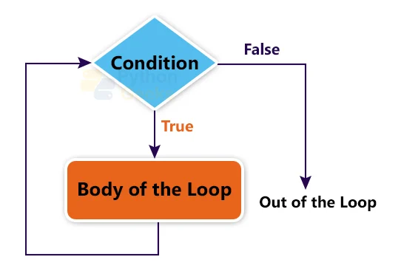
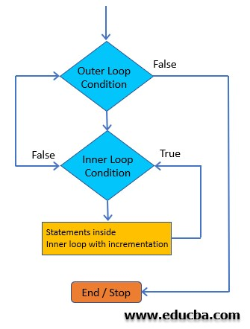
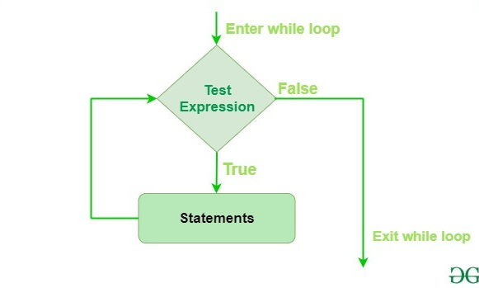
For loop Syntax -
Nested loop Syntax -
While loop Syntax -

Slide 23
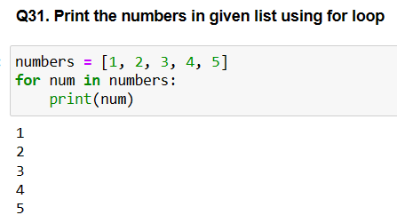
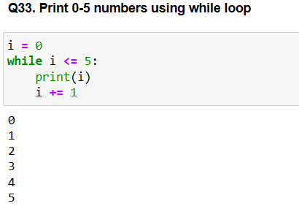
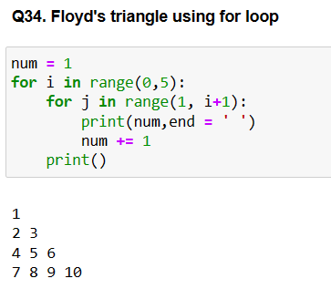
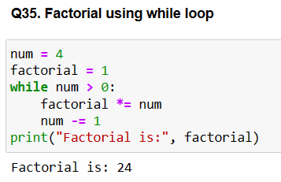
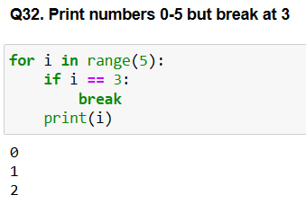
Examples of Looping (for, while, nested) -

Slide 24
INHERITANCE
Built-in functions are pre-defined functions, they have various purposes and can perform common tasks such as mathematical calculations, string manipulation, data type conversion, input/output operations, and more. Some common examples of built-in functions len() for getting the length of a sequence (such as a string, list, or tuple), sum() for calculating the sum of elements in an iterable, sorted() to sort the sequence etc.

Slide 25
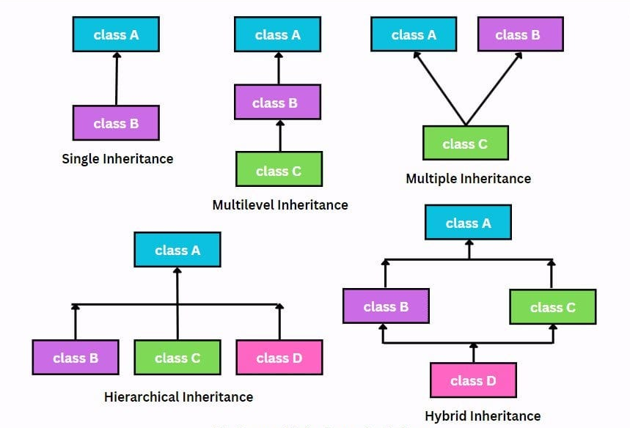
Types of
Inheritance -

Slide 26
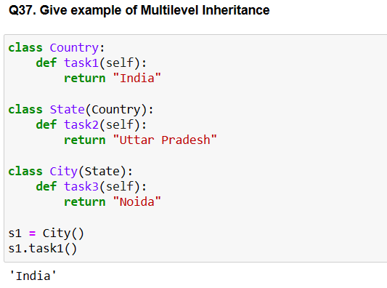
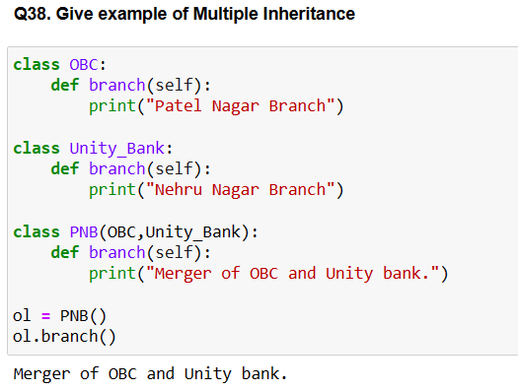
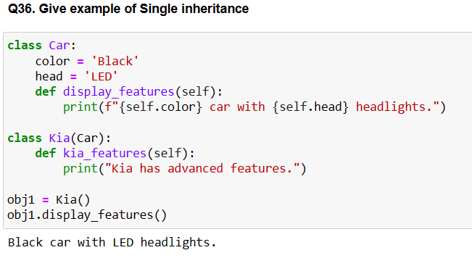
Examples of Inheritance (single, multiple, multilevel) -

Slide 27
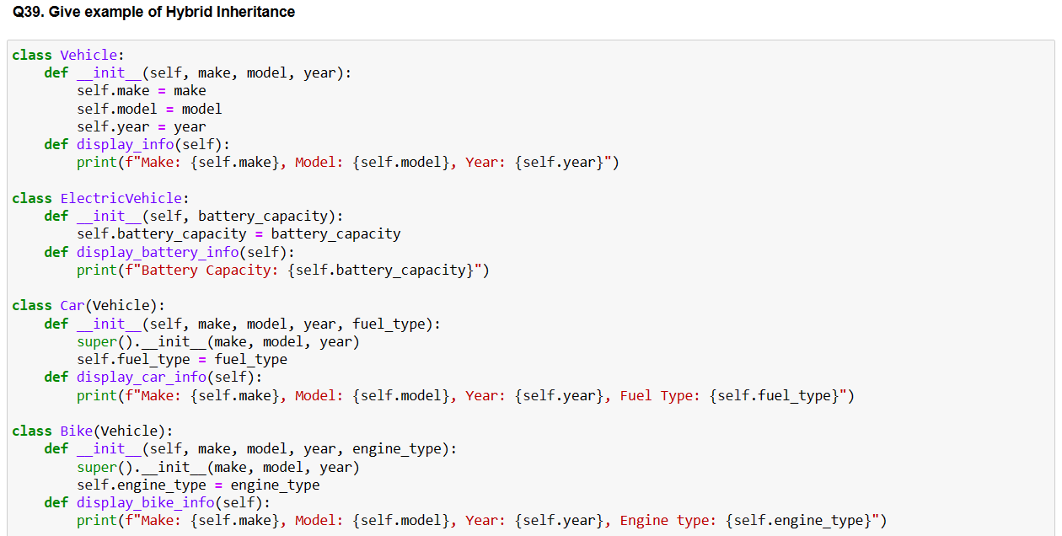
Examples of Inheritance (hybrid) -

Slide 28
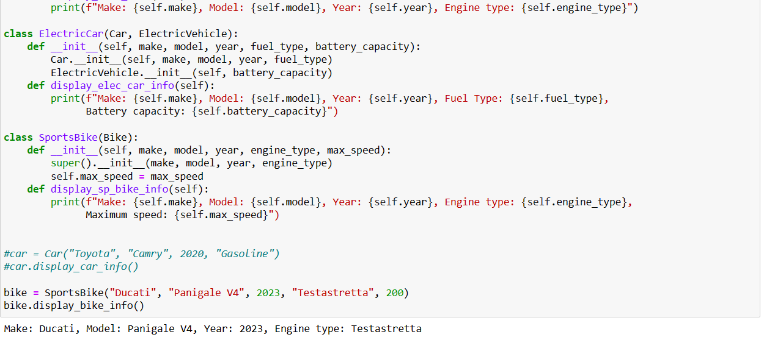
continued -

Slide 29
UDF
User Defined Functions
User-Defined Function (UDF) is a custom function created by a programmer to perform a specific task in a program. Arguments are the values that you provide to a function when you call it. Parameters are variables defined within the function that receive the values passed as arguments.

Slide 30
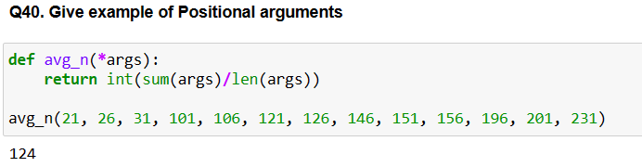


Examples of UDFs -

Slide 31
PATTERNS
AND
LOGICAL
QUESTIONS

Slide 32



Examples of Patterns -

Slide 33



Examples of Logical Questions -

Slide 34

Examples of Logical Questions -

Slide 35

Examples of Logical Questions -

Slide 36

THANK
YOU !

